Slide 1

Using Light-field Angular Coherency for Depth Estimation
15-663 Computational Photography Final Project
Rutika Moharir
Notes:
Hello everyone. My name is Rutika Moharir, and here is my final project presentation for 15663: Computational Photography course at CMU.
My project title is Using Light-field angular coherency for depth estimation.

Slide 2
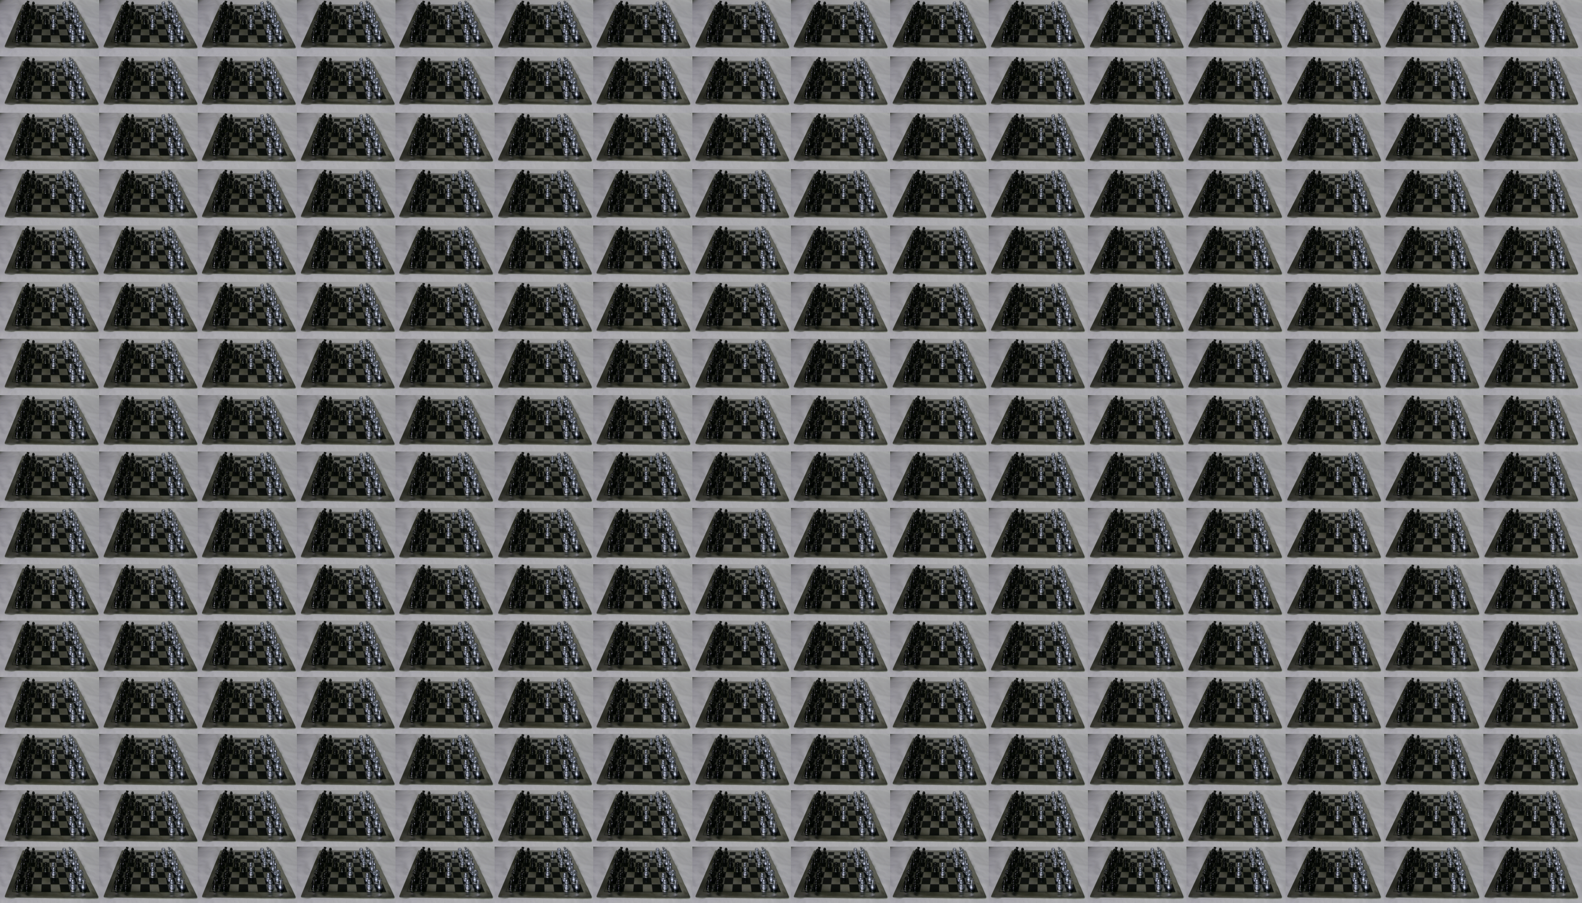
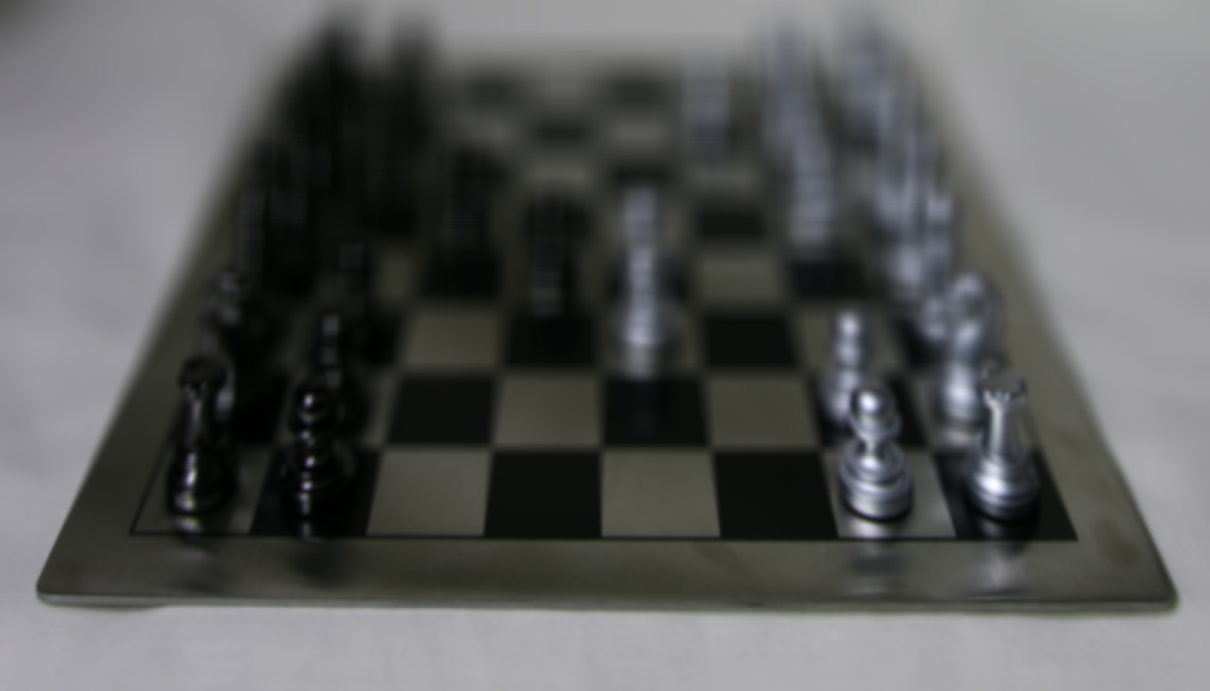
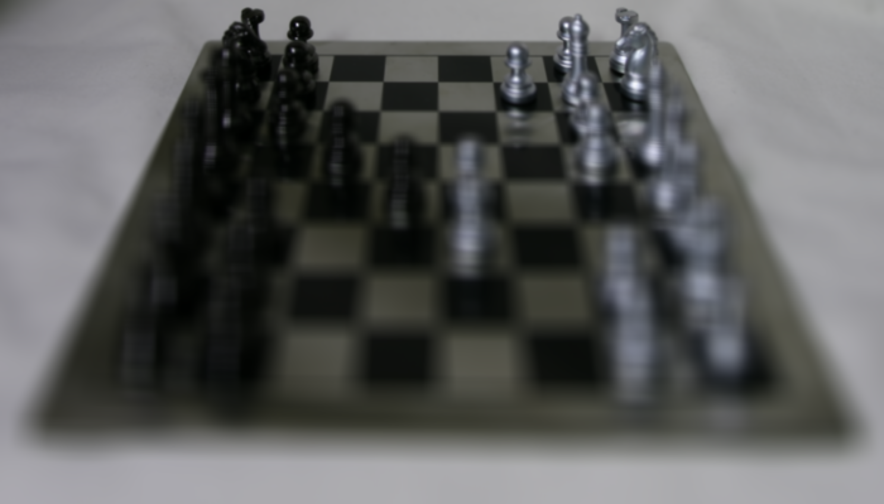
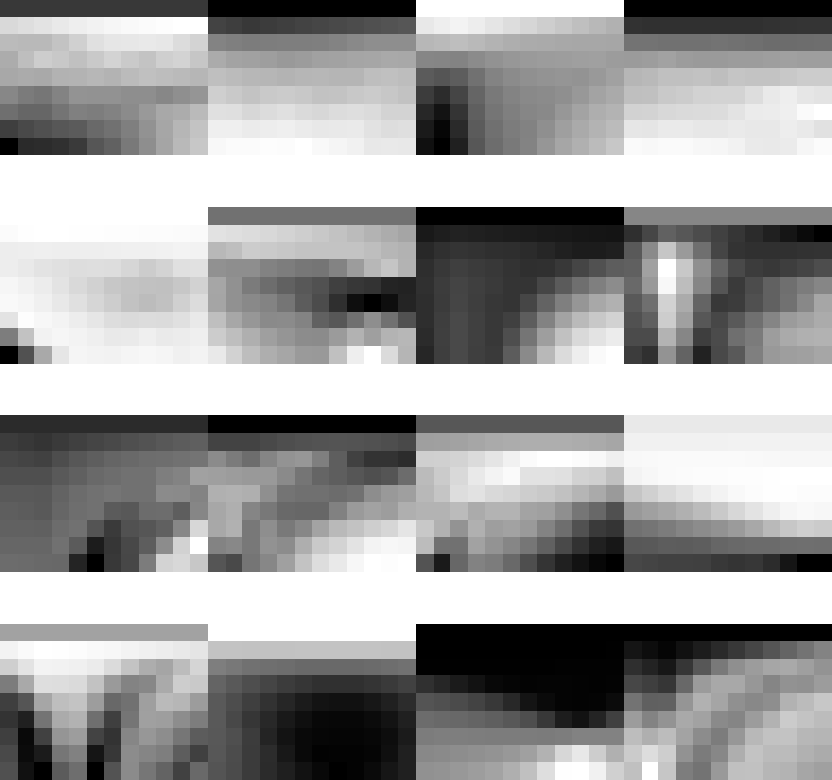

Recap: Light-field Images
v
t
u
s
v
t
u
s
Notes:
As we discussed in class by rearranging the pixels in the lightfield image, we can create images that correspond to views of the scene through a pinhole placed at different points on the camera aperture (a “sub-aperture”). This is equivalent to taking a slice of the lightfield of the form L(u = uo, v = vo, s, t, c), for some values of uo and vo corresponding to the point on the aperture where we place the pinhole.
a few example per-pixel aperture-focus images (AFIs)

Slide 3
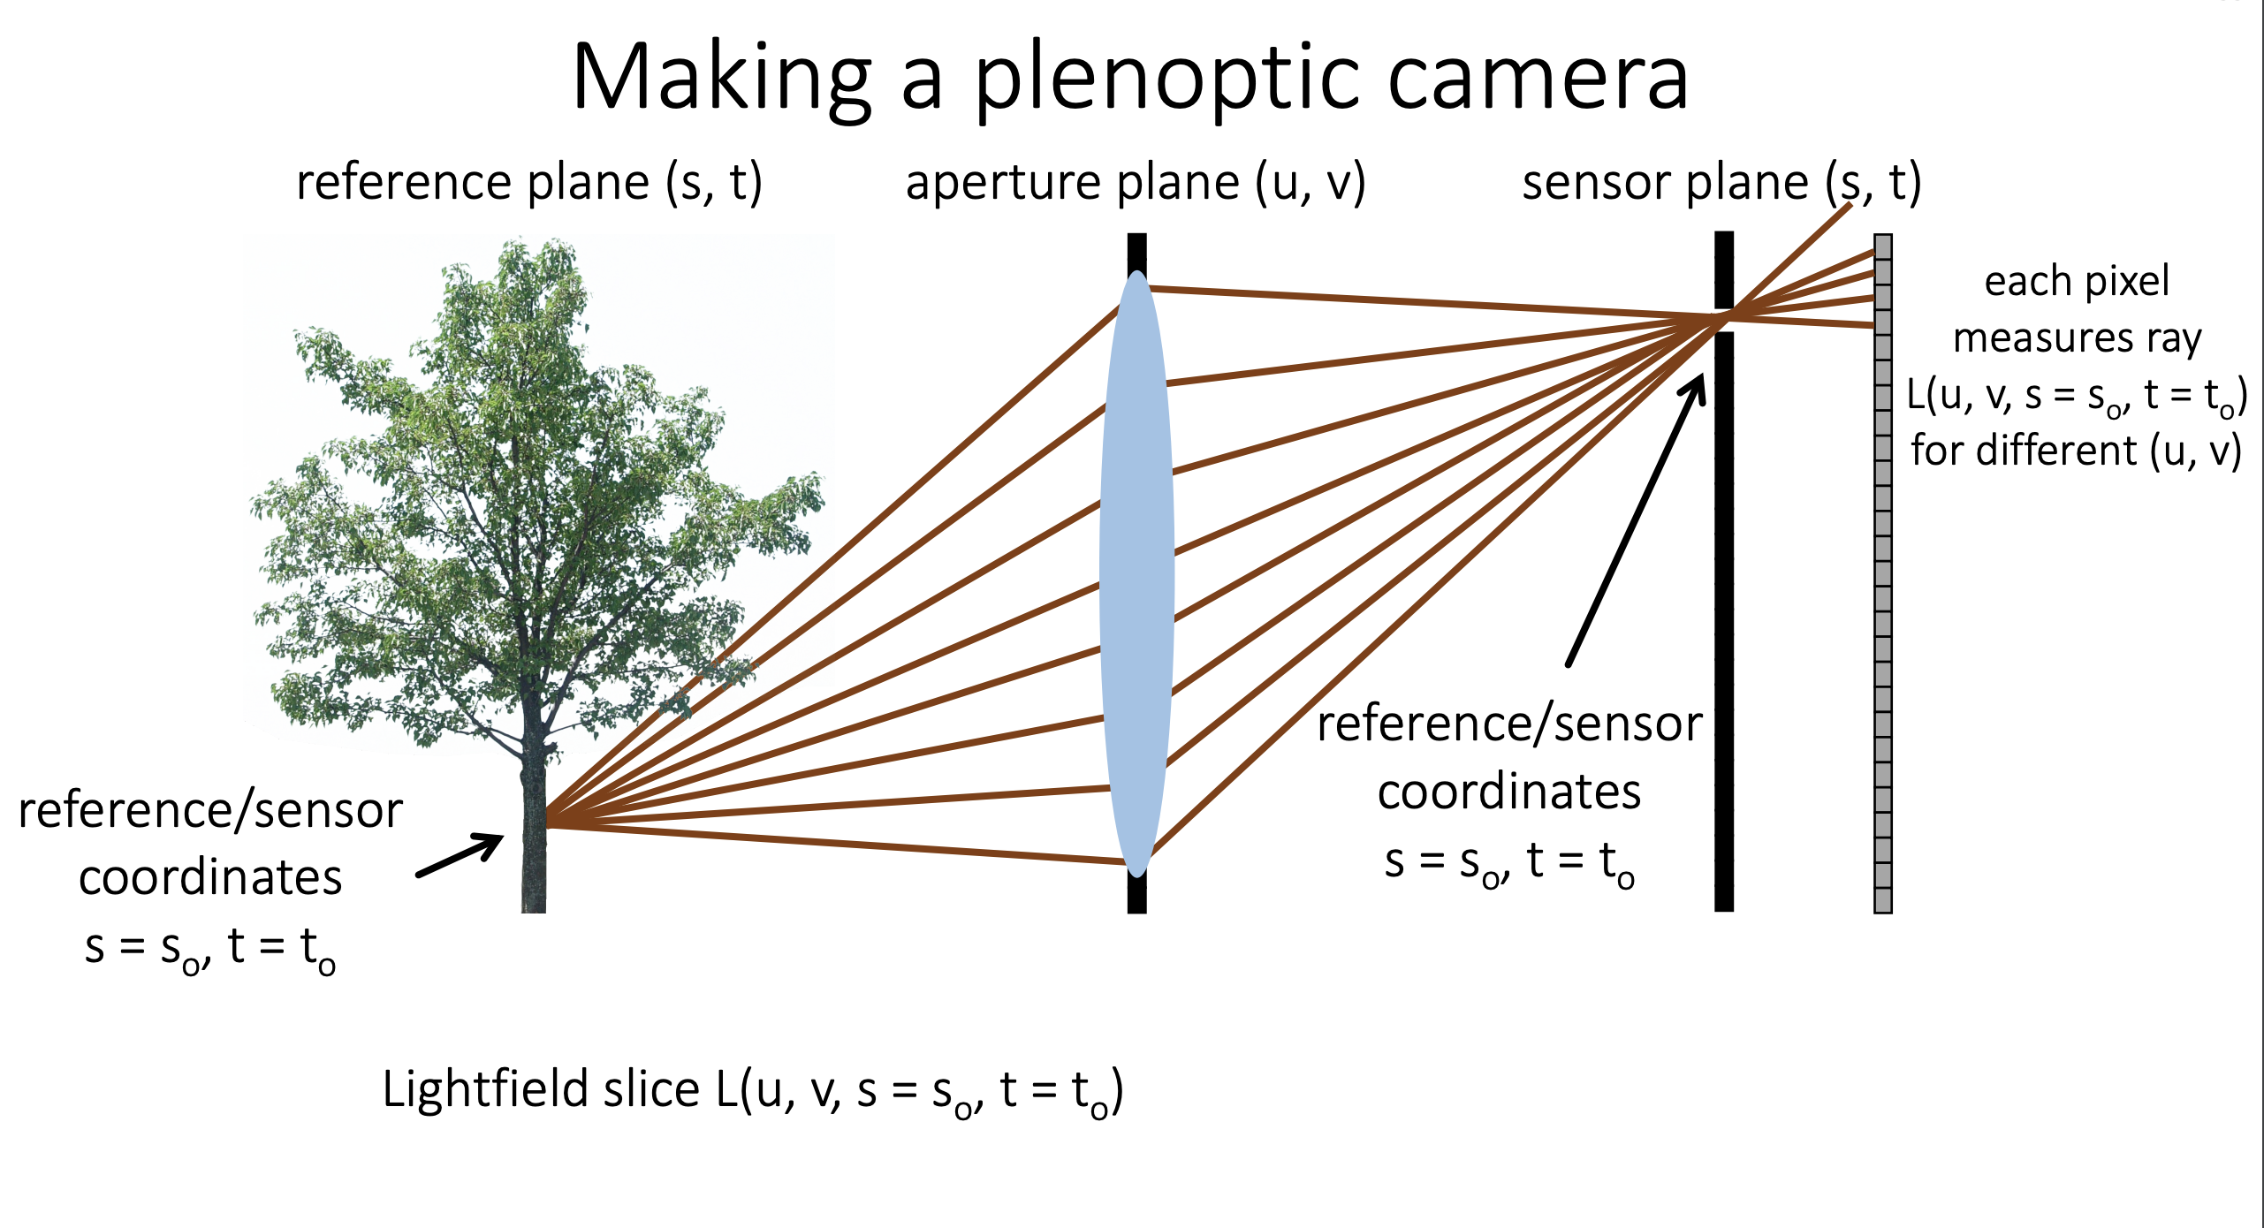
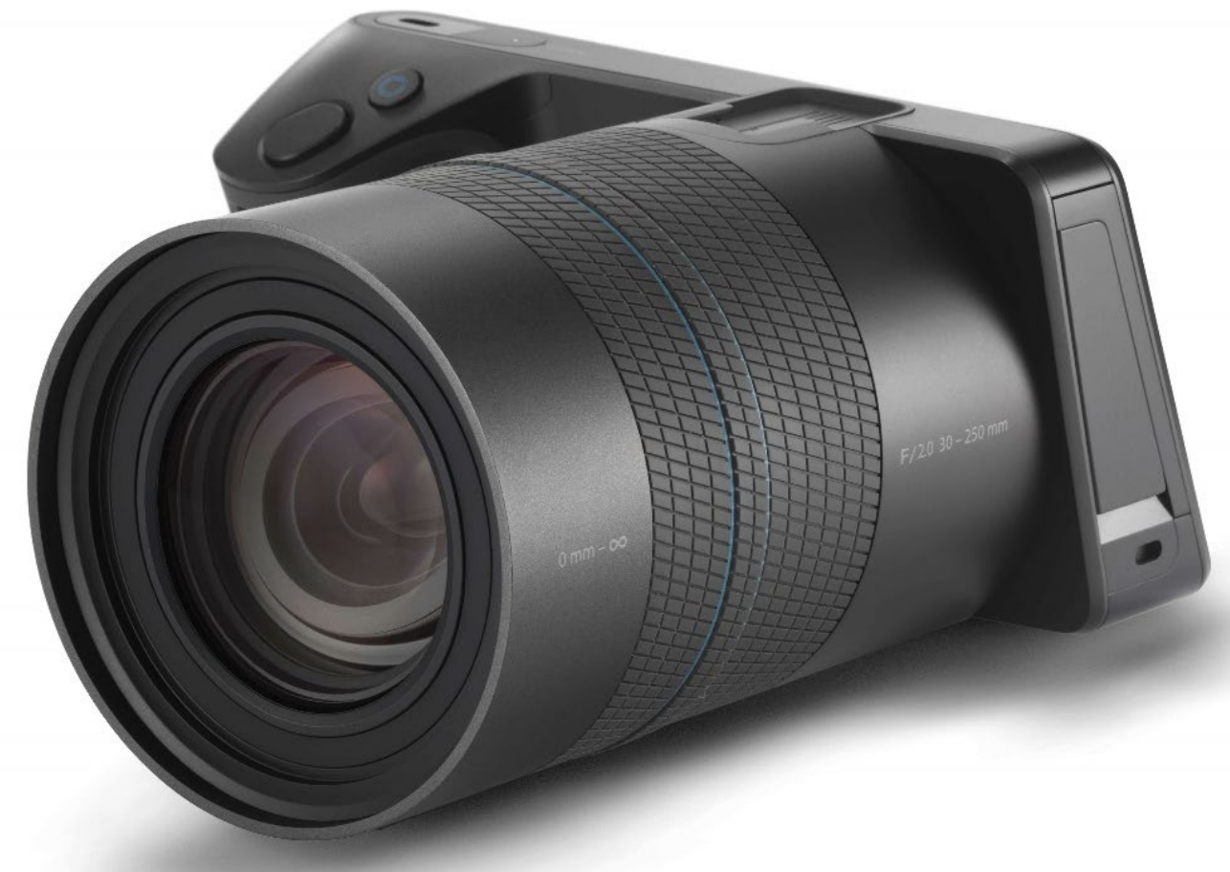
Recap: Plenoptic camera
We can capture RAW Lightfield images using Lytro Illum
Reference: http://graphics.cs.cmu.edu/courses/15-463/lectures/lecture_10.pdf
Notes:
A plenoptic camera can be created by displasing the sensor plane a little further behind sych that each sensor pixel measure ray (u, v, s0, t0)
This is what is done in commercial plenoptic cameras such as lytro illum. This camera has been used to capture real world lightfield images that are used in this project.

Slide 4

Cues from Light-field Image
Viewpoint Variation
All-in-focus Image
Notes:
As we can see, having access to the full lightfield of a scene allows us to create images that correspond to different viewpoint, aperture, and focus settings.
We also get a focal stack which allows creating an all-in-focus image and a depth map using depth from focus.

Slide 5
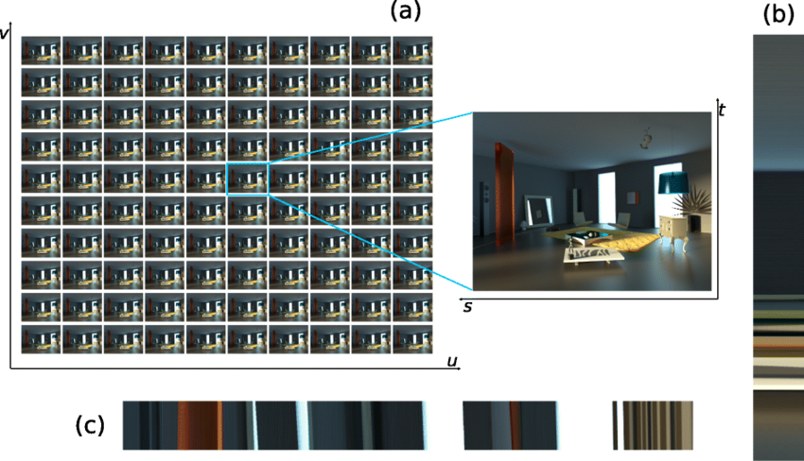
Depth from defocus and correspondence
Defocus Cues
Correspondence Cues
Notes:
Another approach for depth estimation from lightfield images, is to exploit the defocus and correspondence cues
A method in which these cues are used to estimate the optimal depth α at each pixel is by measuring spatial contrasts between the pixels.
Here the 4D light-field data is represented as an epipolar image (EPI) with parameters (𝑥, 𝑢) where u is the angular dimension (along on the lens aperture) and x is the spatial dimension (along the scanline).
By integrating over the angular 𝑢 dimension and computing the variance in 𝑥 dimension we can get the defocus cue where high value means the point is in focus.
The correspondence cue can be calculated by measuring the the angular 𝑢 variance, where low variance indicates correct correspondence.
However using these methods for depth estimation is not ideal for scenes where the object is mainly textureless. We need further guidance for depth estimation.

Slide 6
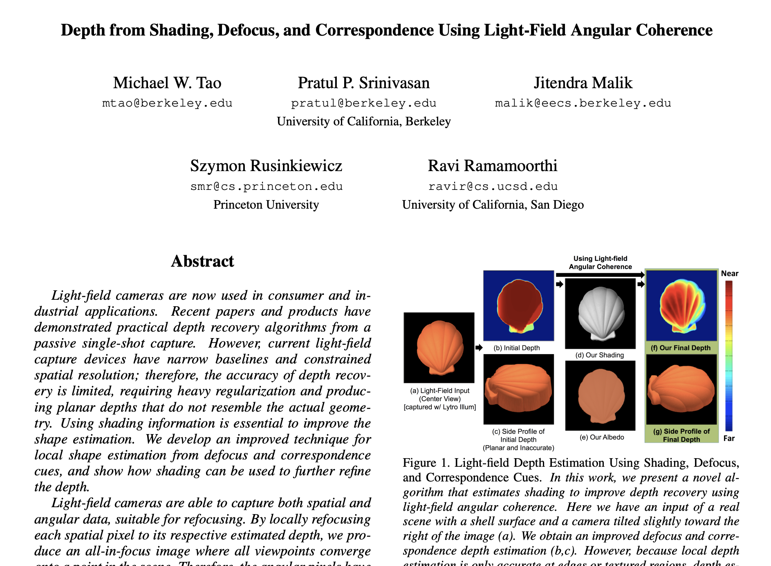
Prior Work
Reference: https://cseweb.ucsd.edu/~viscomp/projects/LF/papers/CVPR15/shading_CVPR15.pdf
Notes:
This project is based on this paper that explores an approach which enables highly accurate depth recovery using not only the regularly used cues of defocus and correspondences, but improves the depth estimation by using cues from shading which helps refine the details in the objects’s shape

Slide 7
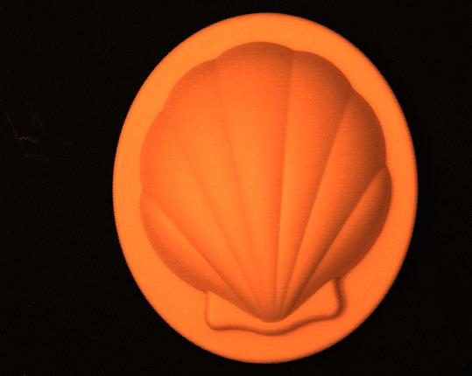
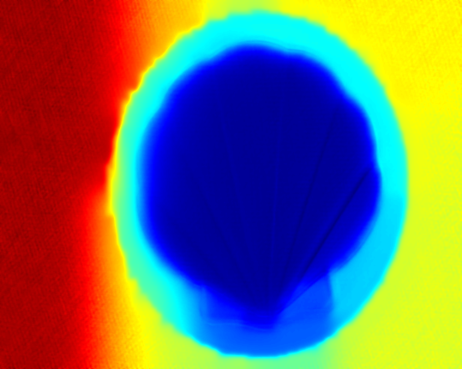
Input and Output
Notes:
Hence, to define our problem statement, given a light-field image of a real world object captured using the Lytro camera, we wish to accurately determine its depth and hence its shape.

Slide 8
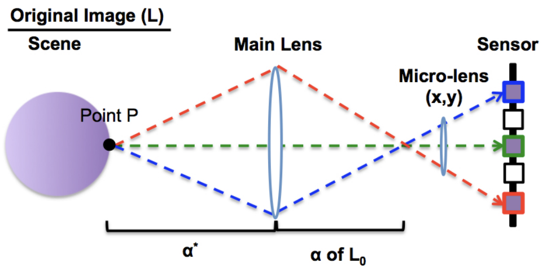
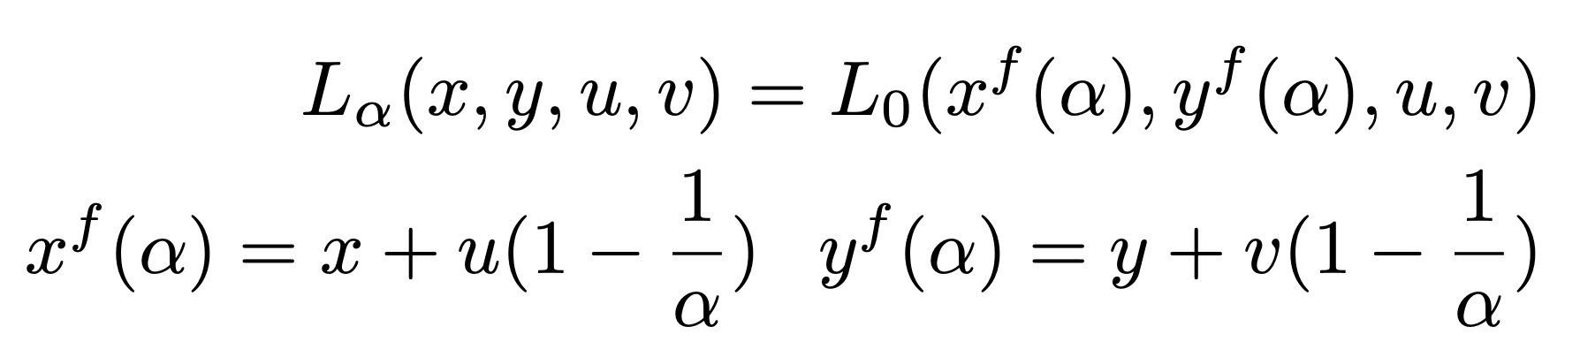
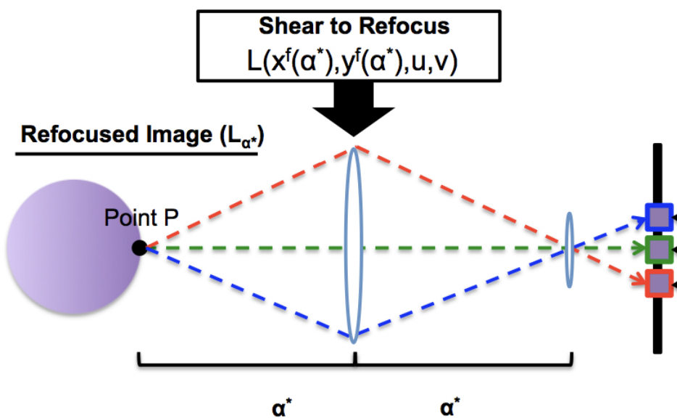
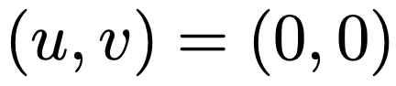
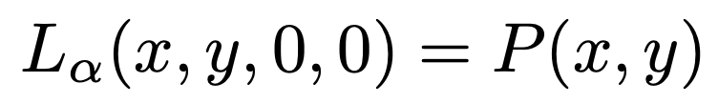
Angular Coherency
How to exploit angular coherency?
Use the central pinhole image!
EPI Remapping
Central Pinhole Image
Angular rays convergence
Angular coherency
Notes:
In a scene where the main lens is focused to point X with a distance α ∗ from the camera,
the micro-lenses enable the sensor to capture different viewpoints represented as angular pixels as shown in this figure.
But how can we exploit this angular coherency?
We use the central pinhole image.
To shear the full 4D light-field image in order to refocus it to depth α, we remap the light field as follows,
where L is the input light-field image, Lα is the refocused image, (x, y) are the spatial coordinates, and (u, v) are the angular coordinates.
The central viewpoint is located at (u, v) = (0, 0).
Given the depth α ∗ (x, y) for each spatial pixel (x, y), we calculate Lα∗ by refocusing each spatial pixel to its respective depth. Hence all angular rays converge to the same scene point when refocused at α ∗
This is known as angular coherence
But since α ∗ is unknown we exploit the fact that for the center pinhole image P, where the angular coordinates are at (u, v) = (0, 0), the sheared x f (α), yf (α) are independent of (u, v). Hence The central angular coordinate always images the same point in the scene, regardless of the focus.

Slide 9
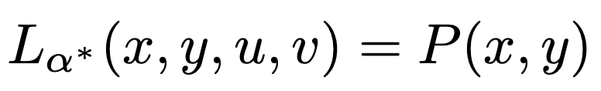
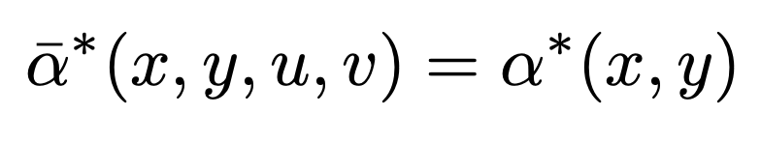
Cues from Angular Coherency
Photo Consistency
Depth Consistency
Shading Consistency
Notes:
This property of refocusing allows us to get constraints to get defocus, correspondence and shading cues. Namely,
For photo consistency In Lα∗ , since all angular rays converge to the same point in the scene at each spatial pixel, the angular pixel colors converge to P(x, y) Therefore, we represent the photo consistency measure as,
For depth consistency the angular pixel values should also have the same depth values giving us
For Shading consistency. Similar to the photo consistency of angular pixels for each spatial pixel in Lα∗ , shading consistency also appli.s, since shading is viewpoint independent for Lambertian surfaces. Therefore, when solving for shading across all views, shading consistency gives us

Slide 10
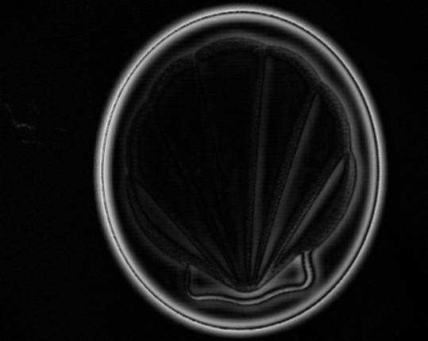
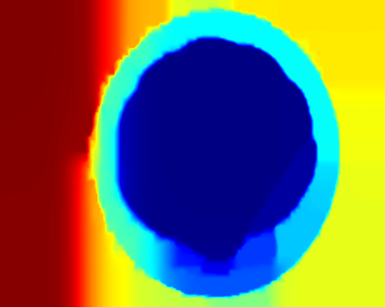
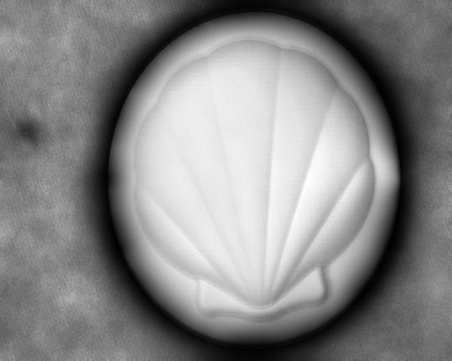
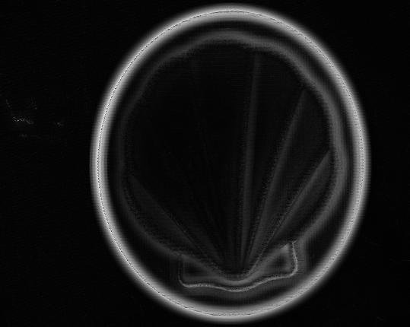
Updated Pipeline for Depth Estimation
Local depth estimation
Regularize w/o shading
Estimate Shading
Estimate Lighting
Regularize w/ shading
Defocus Confidence
Central Pinhole view
Lighting
Final depth
Initial depth
Shading
Correspondence Confidence
Notes:
Following this, the depth estimation pipeline can be explained as follows
The first step is to locally estimate the depth
which provides both confidence and local depth estimation
These two are then used to regularize depth without shading cues The depth is planar, which motivates the use of shading information to refine the depth.
We first estimate shading, which is further used to estimate lighting
Finally the lighting, shading, initial depth, and confidence is used to regularize the final depth

Slide 11
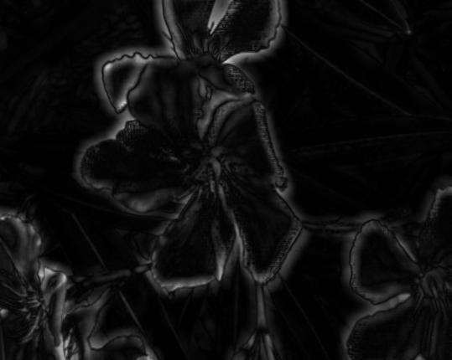
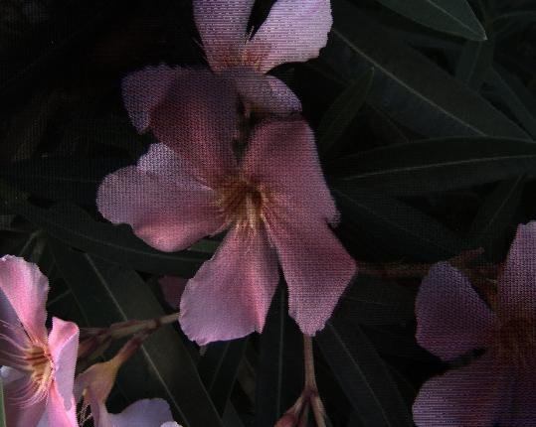
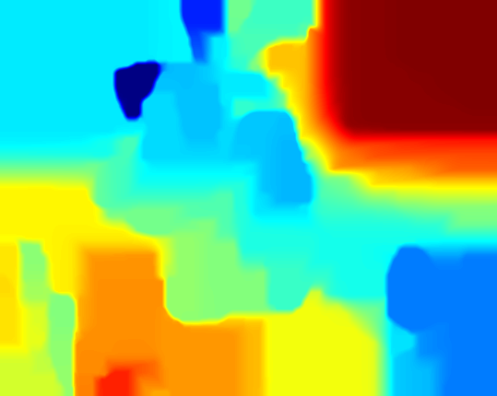
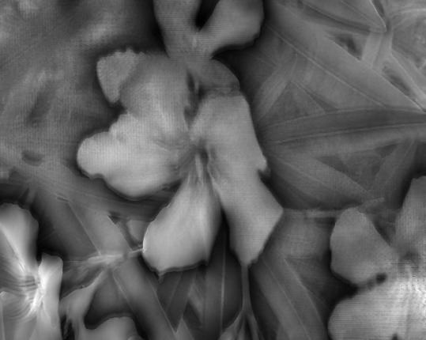
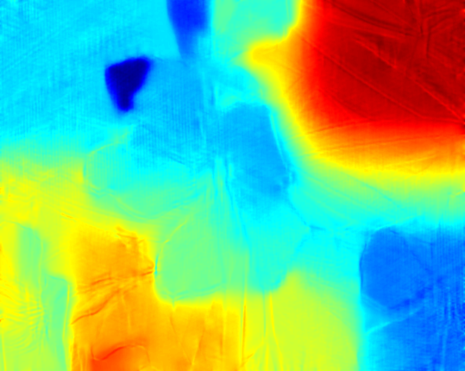
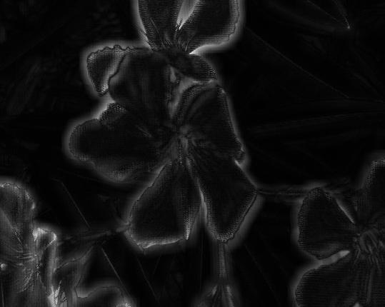
Result: Flower
Defocus Confidence
Central Pinhole view
Initial depth
Shading
Final depth
Correspondence Confidence
Notes:
This is the result on a flower image. Defocus consistently shows better results at noisy regions and repeating patterns, while correspondence provides sharper results. But still even after combining both cues you can see the initial depth is mostly planar in low texture areas.
However, we can see how the angular coherency help estimate highly accurate shading and hence detailed depth. Hence proving the need for shading constraints.

Slide 12
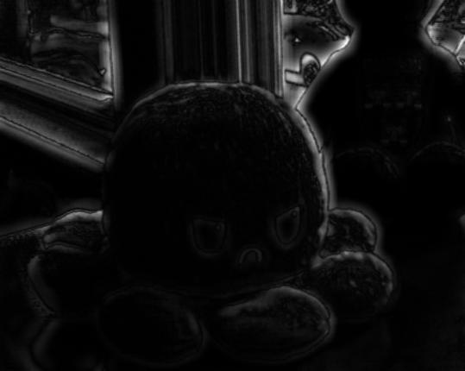

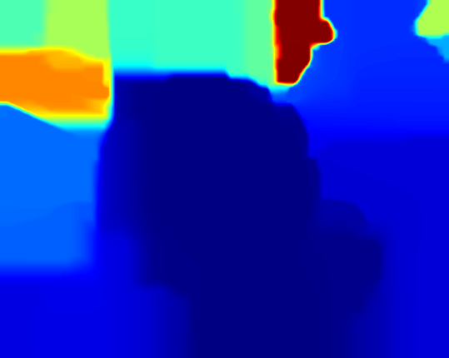
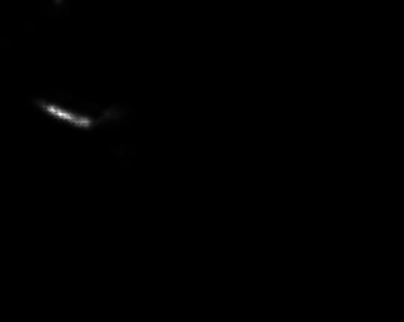
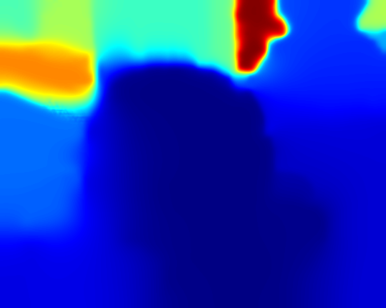
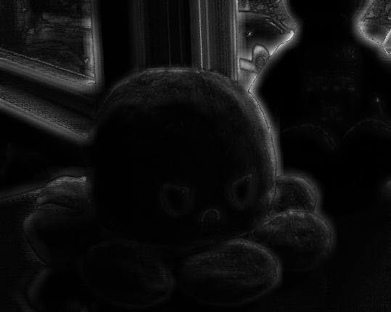
Failure case: Toy
Defocus Confidence
Central Pinhole view
Initial depth
Shading
Final depth
Correspondence Confidence
Shading estimate is incorrect!
Notes:
Even though the approach worked very well in the flower image, it doesn't work that well on all iamges. For examples, here the shading estimate is inaccurate,
hence the final depth is not that different from the initial depth.

Slide 13
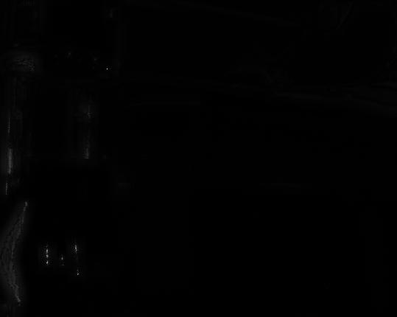
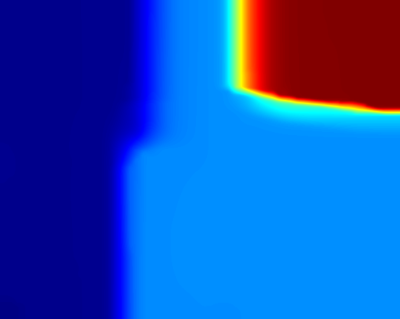
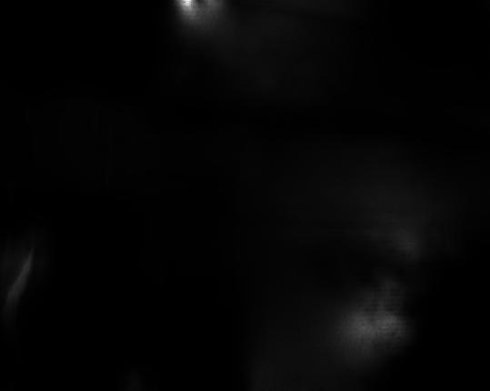
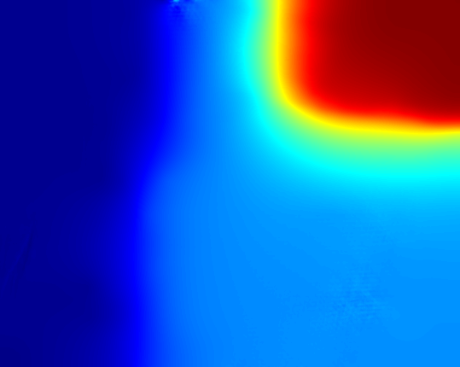
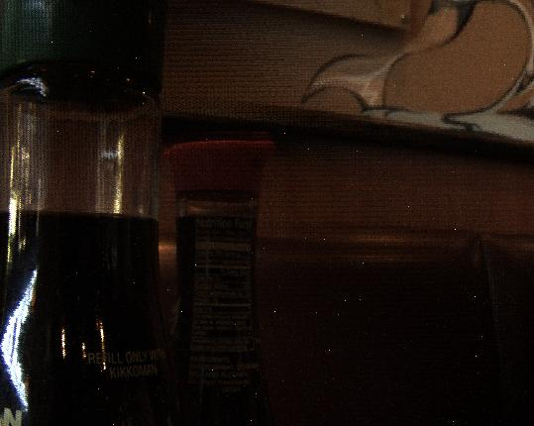
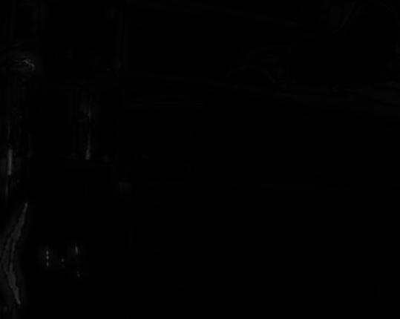
Failure case: Bottle
Defocus Confidence
Central Pinhole view
Initial depth
Shading
Final depth
Correspondence Confidence
Due to specularity the initial depth map is incorrect!
Notes:
Another failure case is specular objects like this image of a bottle.
Since the algorithm works on the assumtion that we are picturing lambertian surfaces,
the defocus and correspondence response is mostly negligible hence giving us planar depth.

Slide 14
Solution:
Identify and remove the specular component!
Observation:
Specular pixels will have higher intensities in the estimated lighting.
Problem:
Classify every pixel as diffuse or specular.
Approach:
Along with the lighting estimation, measure its confidence at every pixel.
Reference: https://ieeexplore.ieee.org/document/6143951
Notes:
Hence as a possible solution would be to identify and remove the specular component.
I tried to implement a simple approach based on the observation that Specular pixels will have higher intensities in the estimated lighting.
Therefore our task is to classifiy every pixek in the lighting estimate as diffuse or specular.
One approach is to estimate a confidence measure (i.e. high confidence if a pixel is specular) along with the lighting estimation

Slide 15
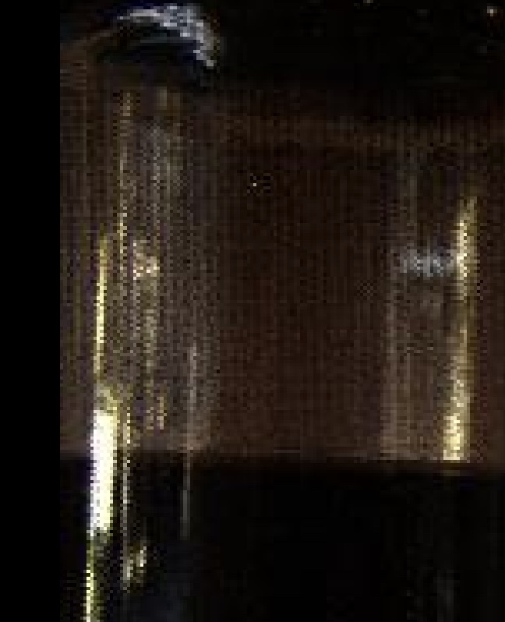
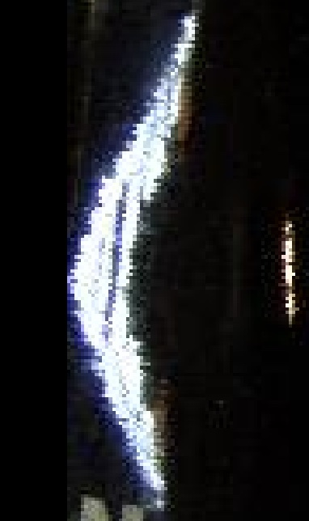
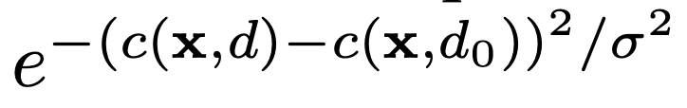
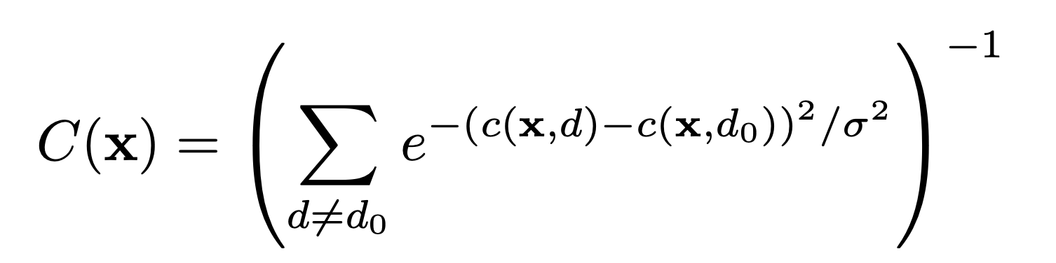
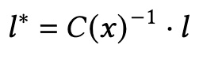
Approach
A possible confidence metric is the Attainable Likelihood Measure. Assume that specularity causes gaussian perturbation to the cost function c(x, d). The likelihood of true lighting l₀ at true depth d₀ will be
High confidence : single sharp minimum.
Low confidence : sever low minimum
Reference: https://ieeexplore.ieee.org/document/6143951
Notes:
For this I used a metric known as Attainable likelihood measure.
we first remap the lighting estimate to the desired depths from 1 to 256. To estimate the lighitng confidence at each pixel, we assume that the cost, here the lighting at each pixel, $C(x, d)$ is perturbed by a gaussian noise due to the specularity. We wish to estimate the true lighting $l_0$ at the true depth $d_0$ which does not have the lowest cost after the cost is perturbed. The likelihood is proportional to
The confidence C(x) is defined as the inverse of the sum of these probabilities for all possible depths
This equation produces a high confidence when the cost
has a single sharp minimum. The confidence is low when
the cost has a shallow minimum or several low minima.
After mesuring the confidence of the lighting estimate
Then the final lighting estimation is

Slide 16
Failure case: Bottle
Central Pinhole view
Initial depth
Final depth
Notes:
Here are the results after reweighing of the estimated lighting. Unfortunately I couldn't get much improvest Hene I plan to continue working on this so that the pipeline can be used for any real world images irrespective of being lambertian or non lambertian

Slide 17
Thank you!
Notes:
That is all I have for now. Thank you so much for you attention.

